Slide 1
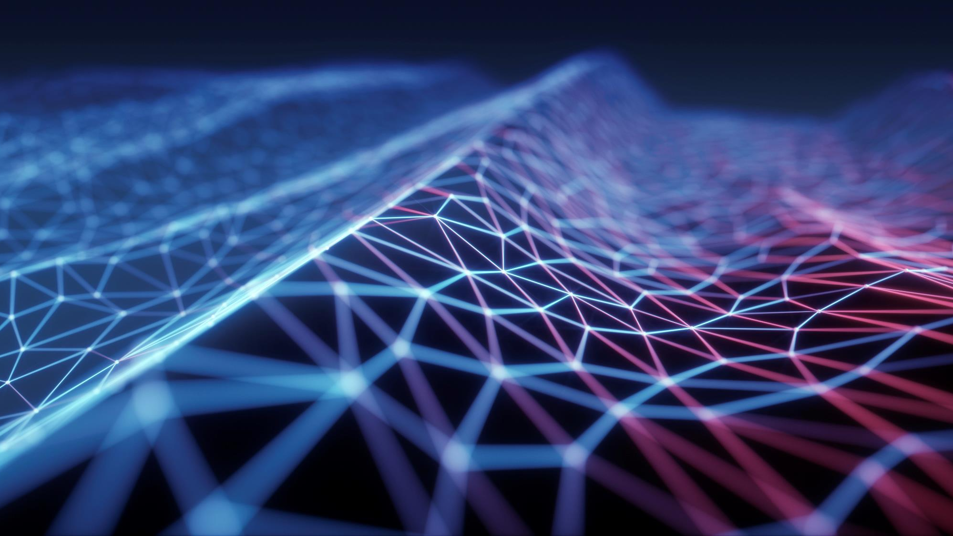
Solar Panels for homes
By Claudia Logrande, arica mcneal, michelle chavez

Slide 2
Introduction presentation
Girl Power team
We are a group of single moms, teamed up to work on this project helping each other just like we do in life to better ourselves and learning from each other.
We have different backgrounds but the same goals to better ourselves by learning new things and succeeding. Also, to set a good example for our kids and point them in the right direction by showing them we're never too old to learn new things.

Slide 3
Claudia Logrande
International student in the USA (originally from Italy).
Very involved in environmental issues
Single mom of 3 kids
Finished my BA in Business, concentration in Finance only in 2020, then started this program with WOZU because I wanted to learn more about Data Science. Looking forward to learn more about it and taking more classes starting in the Fall.

Slide 4
Arica mcneal

Slide 5
Michelle chavez

Slide 6
Why Solar panels from home
Energy costs have been rising every year, our story began on looking for ways to save money in the long run using solar panels for homes.
Another reason why we wanted to research this subject is because it’s an efficient and greener way to use the natural power of the sun to power our household electronics.

